Slide 1
컴퓨터 네트워크 Computer Networks and Internets, 6e

Slide 2
Chapter 17 LAN Extensions: Fiber Modems, Repeaters, Bridges, and Switches

Slide 3
Solving Problems
What are the fields in an Ethernet frame? Explain each field(size and content).
Header(dest. Addr, src addr , type) + Payload + CRC
6B 6B 2B 46~1500B 4B
2. An Ethernet MAC sublayer receives 24bytes of data from the upper layer. What is the size of an Ethernet frame containing the data?
header(14B) + payload(46B) + CRC(4B)
3. Capture Ethernet frames using “Wireshark” and find out the composition of an Ethernet frame.
© Pearson Education Inc., Upper Saddle River, NJ. All rights reserved.
3
Notes:
3

Slide 4
© Pearson Education Inc., Upper Saddle River, NJ. All rights reserved.
4
Notes:
4

Slide 5
© Pearson Education Inc., Upper Saddle River, NJ. All rights reserved.
5
Notes:
5

Slide 6
17.2 Distance Limitation and LAN Design
Distance limitation is a fundamental part of LAN designs
When designing a network technology, engineers choose a combination of factors that can be achieved at a given cost
Capacity
Maximum delay
Distance
Cost
LAN technologies maximize data rate and minimize cost
General principle: A maximum length specification is a fundamental part of LAN technology; LAN hardware will not work correctly over wires that exceed the bound.

Slide 7
Technologies That Extend LANs
Variety of techniques have been invented to extend LANs Three key extension technologies
Fiber modems
Repeaters
Bridges.

Slide 8
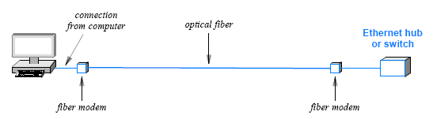
17.3 Fiber Modem Extensions
Communicate over an optical fiber
Can span long distance
Provide standard network interface (e.g., Ethernet)
can be used to extend connection between computer and network
Illustration of an extended network connection

Slide 9
17.4 Repeaters
Operate at layer 1 (do not understand packets)
Repeat and amplify signals
Low cost
Example use: extended infrared sensor on a cable box

Slide 10
17.5 Bridges and Bridging
Originally sold as stand-alone device to extend two LAN segments
Operates at layer 2
Can connect two or more segments
Listens in promiscuous mode on each segment and sends copy of each frame to other segments
Does not copy noise, collisions, or frames that are incorrectly formed
Makes connected segments appear to be a single, large LAN
Uses source MAC address in frames to learn computer locations automatically, and uses destination MAC address to filter frames

Slide 11
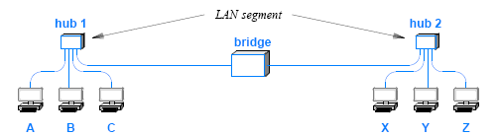
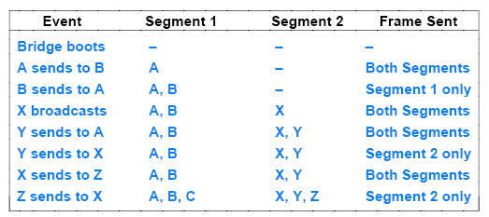
17.6 Learning Bridges and Frame Filtering
Fig 17.3
Fig 17.4

Slide 12
17.7 Why Bridging Works Well
A bridged network can exhibit higher overall performance than a single LAN
Because a bridge permits simultaneous activity on attached segments, a pair of computers on one segment can communicate at the same time as a pair of computers on another segment.
Each segment forms a separate collision domain

Slide 13
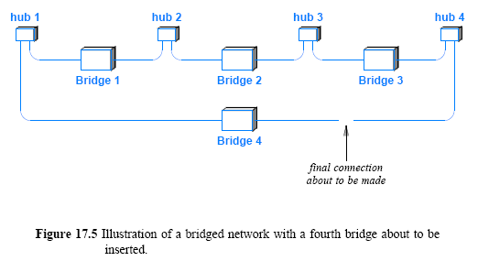
17.8 Distributed Spanning Tree
It shows four LAN segments currently connected by three bridges and a fourth bridge about to be inserted =>loop
What happens if a computer attached to one of the segments sends a broadcast frame? => spanning tree protocol

Slide 14
17.9 Switching and Layer 2 Switches
An Ethernet switch, sometimes called a Layer 2 switch is an electronic device that resembles a layer 2 hub
a switch provides multiple ports that each attach to a single computer
Network device
Connects multiple computers
Computers appear to be attached to a LAN segment
Logically similar to a set of bridged networks:
Switch understands packets, not just signals
No contention, and no need for CSMA/CD
Ports operate in parallel
Switch can include services that examine packets

Slide 15
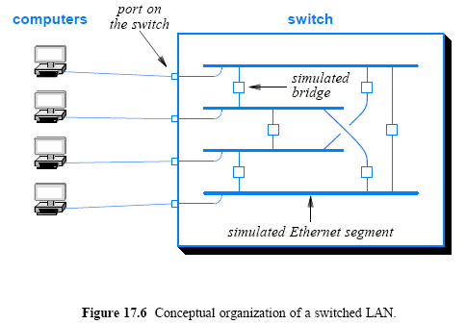
Logical Function Of A Switch

Slide 16
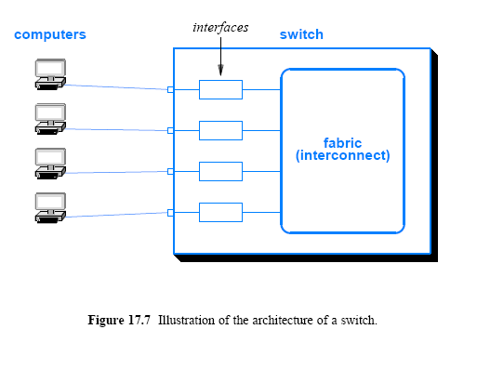
Actual Switch Architecture

Slide 17
Virtual Local Area Network (VLAN) Switch
Physically
Similar to a conventional Layer 2 switch
Has ports to which computer can connect
Logically
Manager can configure one or more broadcast domains
Each port assigned to one broadcast domain
Frame sent to broadcast or multicast address only propagated to ports in the same broadcast domain

Slide 18
Chapter 18 WAN Technologies and Dynamic Routing

Slide 19
A Wide Variety of Networking Technologies
LAN technologies
Token ring (esp., IBM Token Ring)
FDDI/ CDDI
WAN technologies
X.25
Frame Relay
ATM
ISDN
MPLS

Slide 20
18.2 Large Spans and Wide Area Networks
Networking technologies can be classified according to the distance spanned:
PAN spans a region near an individual
LAN spans a building or campus
MAN spans a large metropolitan area
WAN spans multiple cities or countries
Consider a company that uses a satellite bridge to connect LANs at two sites
Should the network be classified as a WAN or as an extended LAN?

Slide 21
18.2 Large Spans and Wide Area Networks
The key issue that separates WAN technologies from LAN technologies is scalability
A WAN must be able to grow as needed to connect many sites
spread across large geographic distances
A technology is not classified as a WAN unless it can deliver reasonable performance for a large scale network
A WAN does not merely connect to many computers at many sites
it must provide sufficient capacity to permit all computers to communicate
Thus, a satellite bridge that connects a pair of PCs and printers is merely an extended LAN

Slide 22
18.3 Traditional WAN Architecture
WAN designers chose to create a special-purpose hardware device that could be placed at each site
A packet switch provides
local connections for computers at the site
as well as connections for data circuits that lead to other sites
A packet switch consists of a small computer system
with a processor, memory, and I / O devices used to send and receive packets
Early packet switches were constructed from conventional computers
the packet switches used in the highest-speed WANs require special-purpose hardware
Figure 18.1 illustrates the internal architecture

Slide 23
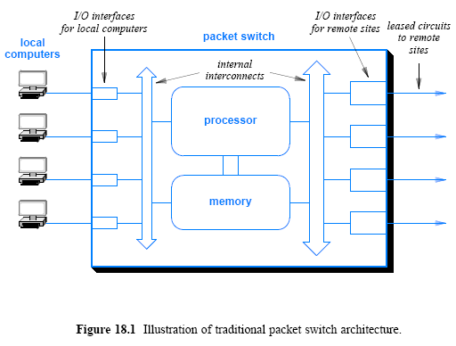
18.3 Traditional WAN Architecture

Slide 24
18.3 Traditional WAN Architecture
Since the advent of LAN technology, most WANs separate a packet switch into two parts:
a Layer 2 switch that connects local computers
a router that connects to other sites
Part 4 of the text
discusses Internet routers in detail
and explains how the concepts covered here apply to the Internet
Communication with local computers can be separated from transmission across a WAN
Figure 18.2 illustrates the separation

Slide 25
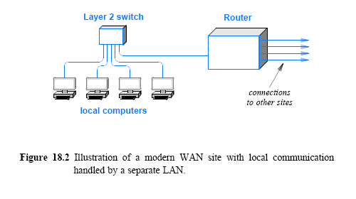
18.3 Traditional WAN Architecture

Slide 26
18.4 Forming a WAN
A WAN can be formed by interconnecting a set of sites
The exact details of the interconnections depend on
the data rate needed
the distance spanned
and the delay
Many WANs use leased data circuits
However, other forms are also available
such as microwave and satellite channels
A network designer must choose a topology
For a given set of sites, many topologies are possible
Figure 18.3 illustrates a possible way to interconnect
a WAN does not need to be symmetric in the interconnections among packet switches
the capacity of each connection can be chosen to accommodate the expected traffic and provide redundancy in case of failure

Slide 27
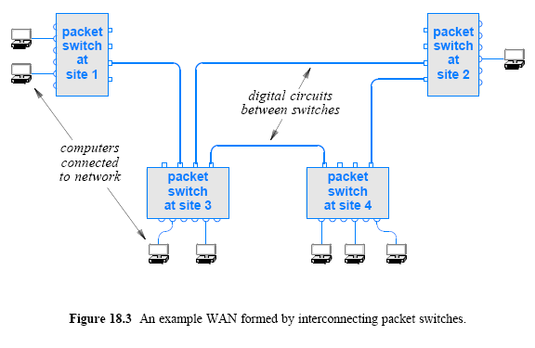
18.4 Forming a WAN

Slide 28
18.5 Store and Forward Paradigm
The goal of a WAN is to allow as many computers as possible to send packets simultaneously
The fundamental paradigm used to achieve simultaneous transmission is known as store and forward
To perform store and forward processing
a packet switch buffers packets in memory
The store operation occurs when a packet arrives:
I / O hardware in the switch places a copy of the packet in memory
The forward operation occurs once a packet has arrived and is waiting in memory. The processor
examines the packet
determines its destination
and sends the packet over the I / O interface that leads to the destination

Slide 29
18.6 Addressing in a WAN
From the view of an attached computer
a traditional WAN network operates similar to a LAN
Each WAN technology defines the exact frame format a computer uses when sending and receiving data
Each computer connected to a WAN is assigned an address
WANs addresses follow a key concept that is used in the Internet: hierarchical addressing
Hierarchical addressing divides each address into two parts:
(site, computer at the site)
In practice, instead of a identifying a site, each packet switch is assigned a unique number
first part of an address identifies a packet switch
second part identifies a specific computer
Figure 18.4 shows two-part hierarchical addresses assigned to computers connected to a pair of packet switches

Slide 30
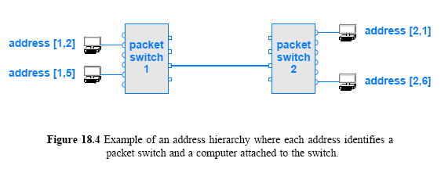
18.6 Addressing in a WAN

Slide 31
Network Delays
Propagation Delay (for each bit)
= distance/velocity m/(m/sec) =>sec
2. Transmission Delay (at sender)
= (amount of data)/(data rate) bits/(bits/sec) =>sec
3. Queuing Delay, ……..
4. Total delay = Transmission Delay + Propagation Delay + …..
© Pearson Education Inc., Upper Saddle River, NJ. All rights reserved.
31
Notes:
31

Slide 32
Assignment
1. Consider a link of 1000m with a bandwidth of 1Gbps, and the propagation speed of 10⁸ m/sec.
a) What is the propagation delay through this line?
b) What is the transmission delay of a packet of 1000bytes?
c) How many bits can be contained in the link at most?
2. Compare Ethernet hubs and Layer2 switches.
3. Where and when does “store and forward processing” occur?
Send your solution to me by email. (Due date: 5.2. )
This assignment will be used to check your attendance.
© Pearson Education Inc., Upper Saddle River, NJ. All rights reserved.
32
Notes:
32

